Slide 1
Shapes Pew Peww
Ryan Gattis
John Boling
Randall Harper

Slide 2
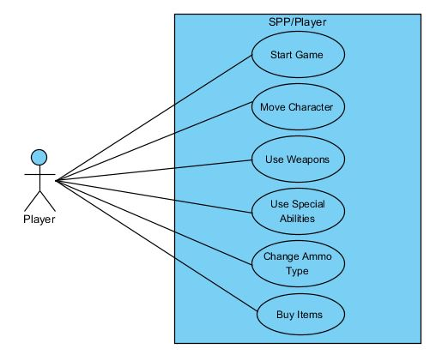
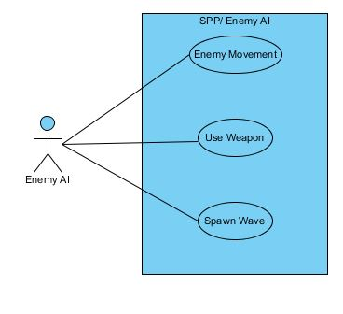
Use Case Diagrams

Slide 3
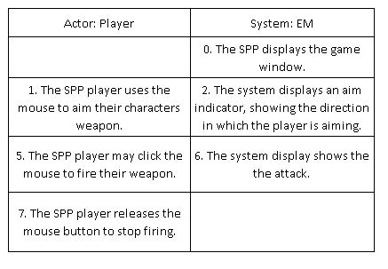
Expanded Use Case – Use Weapon

Slide 4
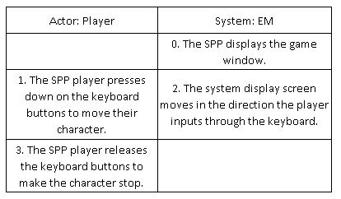
Expanded Use Case – Move Character

Slide 5
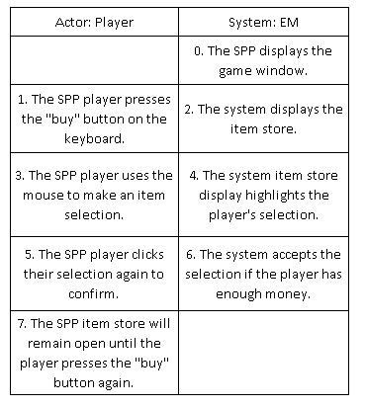
Expanded Use Case – Buy Items

Slide 6
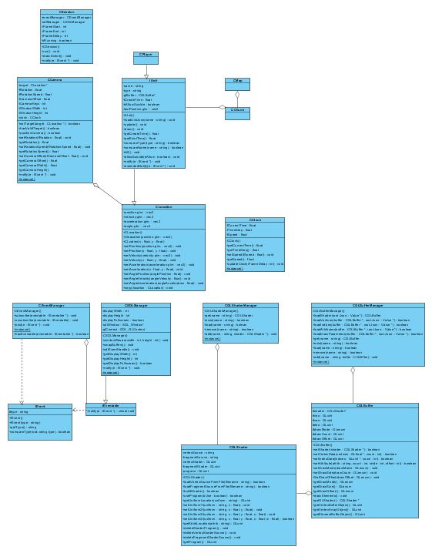
Updated Domain Model
CCamera added
CBlock added
IUnit added
CClock added
CLocation added
Incomplete
CPlayer added
CMap added
CChunk added
All others updated

Slide 7
Updated Team Member Assignments
Team Member | Iteration 2 | Iteration 3
John Boling | Graphics Design Weapons Design | Game Interface Boss Strategy
Randall Harper | Wave Design Enemy Design | Enemy AI
Ryan Gattis | Graphics Implementation Environment Implementation | Weapons Implementation

Slide 8
Appendix

